Slide 1

Brief Introduction of Java 7
Subtitle
Notes:
To change the image on this slide, select the picture and delete it. Then click the Pictures icon in the placeholder to insert your own image.

Slide 2
Contents
Introducing Java 7
NIO2

Slide 3
Title and Content Layout with Chart
The Java language
“A Brief, Incomplete, and Mostly Wrong History of Programming Languages.”
-- James Iry

Slide 4
Two Content Layout with Table
The Java Platform

Slide 5
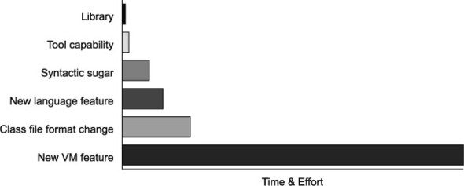
Project Coin
The goal of Project Coin is to determine what set of small language changes should be added to JDK7. (After discussion, 5 out of 70 proposals were selected for JDK7)
Java7 is the first version developed in an open source manner

Slide 6
Project Coin Proposal Judgement Rules
Submit a detailed proposal form describing their change (which should fundamentally be a Java language change, rather than a virtual machine change)
Discuss their proposal openly on a mailing list and field constructive criticism from the other participants
Be prepared to produce a prototype set of patches that could implement their change

Slide 7
Add a Slide Title - 4
Project Coin brought six main new features to Java7:
Strings in switch
Enhanced syntax for numeric literals
Improved exception handling
Try-with-resources
Diamond syntax
Simplified varargs method invocation

Slide 9
Path
The concept of a location
JVM only binds a Path to the physical location at runtime

Slide 10
Add a Slide Title - 6

Slide 11
Add a Slide Title - 7

